Slide 1
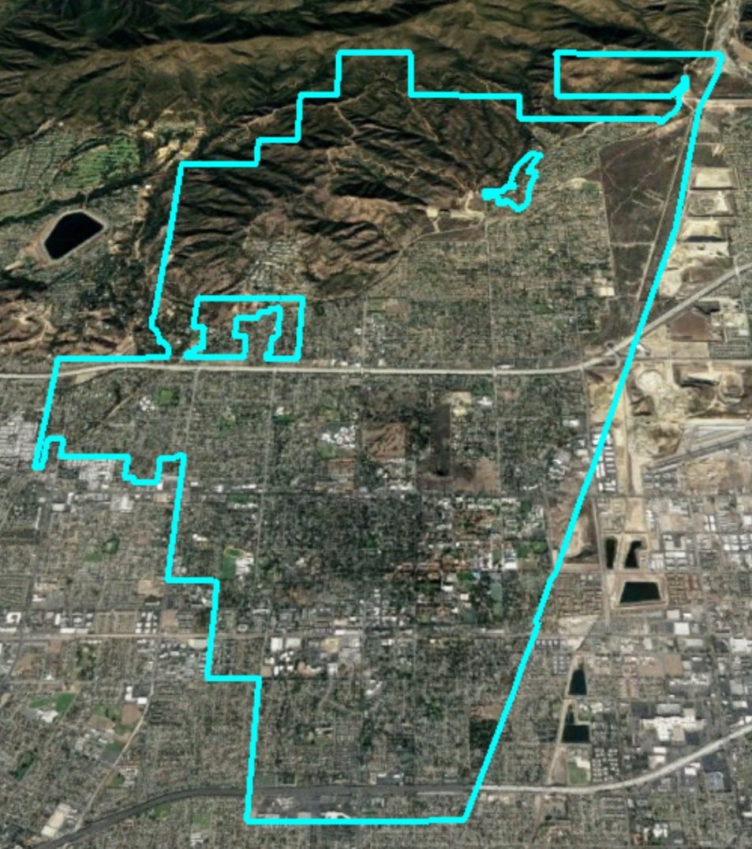
City of Claremont Introduction to Districting

Slide 2
Districting Process
Step | Description
First Hearing: Jan. 8 | Held prior to release of draft maps. Education and to solicit input on the communities in the District.
Community Workshops: Jan. 13 | Presentation of demographics and overview of process to draw district maps. Question and answers.
Second Hearing: Jan. 17 | Held prior to release of draft maps. Education and to solicit input on the communities in the District.
Release draft maps | Maps must be posted at least 7 days prior to 3rd hearing.
First Hearing on Draft Maps: Feb. 4 | Two meetings to discuss and revise the draft maps and to discuss the election sequencing.
Community Workshops: Feb. 9 | Public input on draft maps and proposed sequence of elections.
Second Hearing on Draft Maps: Feb. 12 | Public hearing to discuss and take public comment on draft maps and proposed sequence of elections. Map selection & ordinance introduction.
2020 | First by-district elections
2021 | Map adjusted using 2020 Census data
2022 | Remaining districts hold first by-district elections

Slide 3
Districting Rules and Goals
Federal Laws
Traditional Redistricting Principles
Equal Population
Federal Voting Rights Act
No Racial Gerrymandering
Communities of interest
Compact
Contiguous
Visible (Natural & man-made) boundaries
Respect voters’ choices / continuity in office
Planned future growth

Slide 4
Submitted Maps
31 total maps submitted by residents
10 of those contain five districts, are population balanced, and contiguous
NDC added three maps to round out the available options
Ideally tonight’s discussion will narrow the list to two to four “focus” maps

Slide 5
Not Balanced Maps
All maps are in the Council packets
These maps do not meet legal requirements or have only four districts, but do convey ideas and preferences of the submitters:
103
105
112
117
118
120
121
122
113
108
111

Slide 6
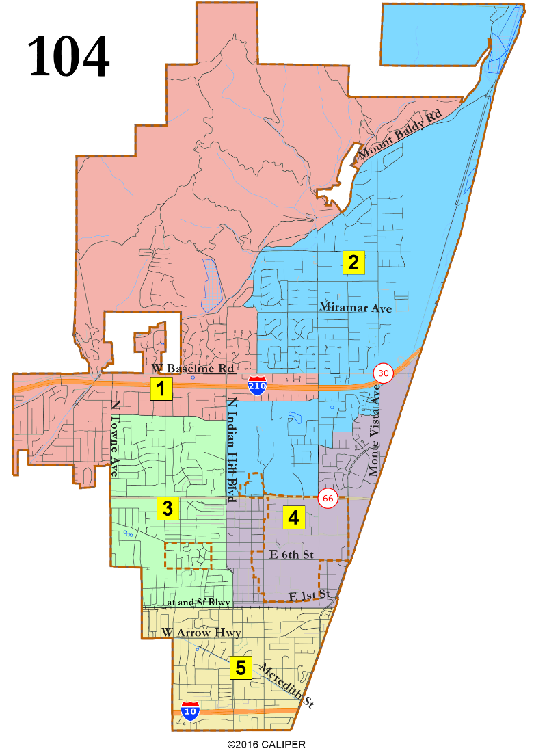
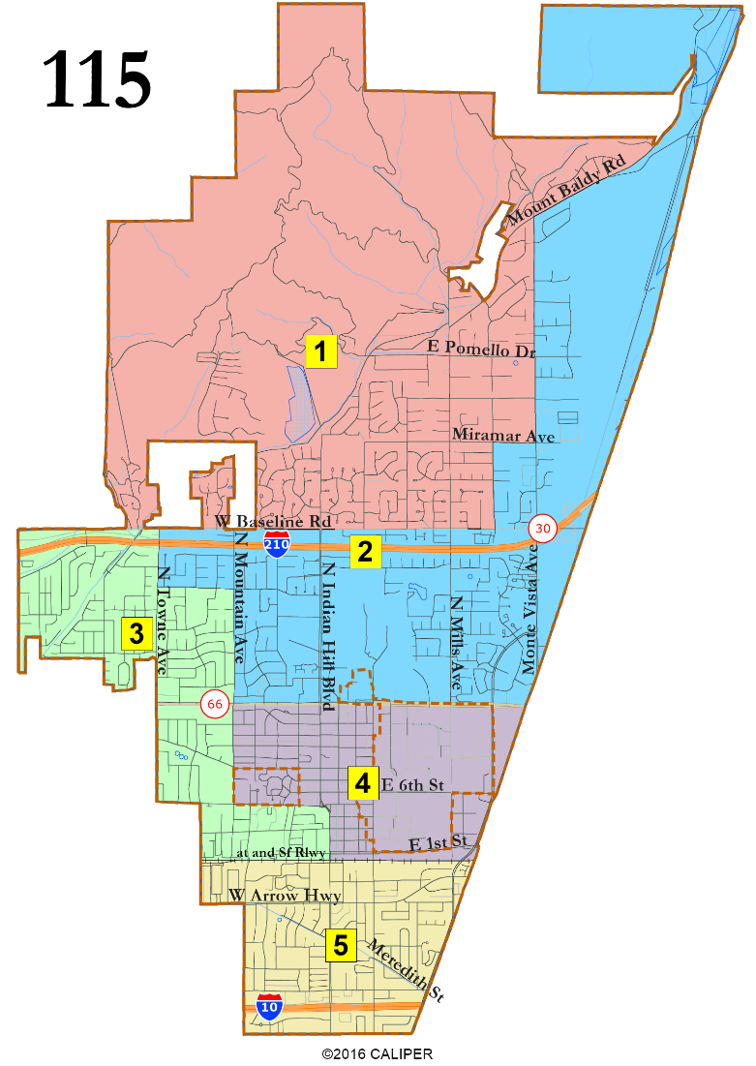
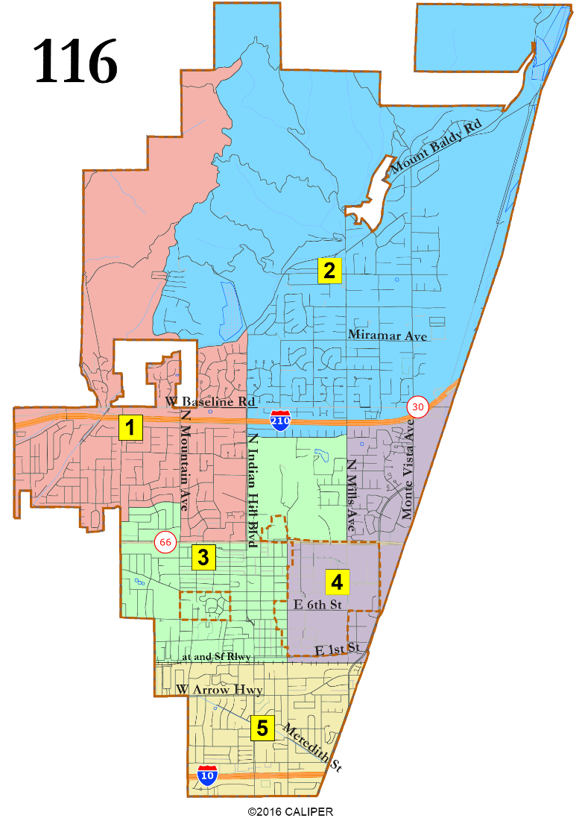
Regions with United Colleges
The Latino percentage of CVAP in D5 is 32% and the Asian-American CVAP in D2 is 20 or 22%. None significantly divides the colleges or Pilgrim Place. All are good on compactness. All have two Council “pairings.”

Slide 7
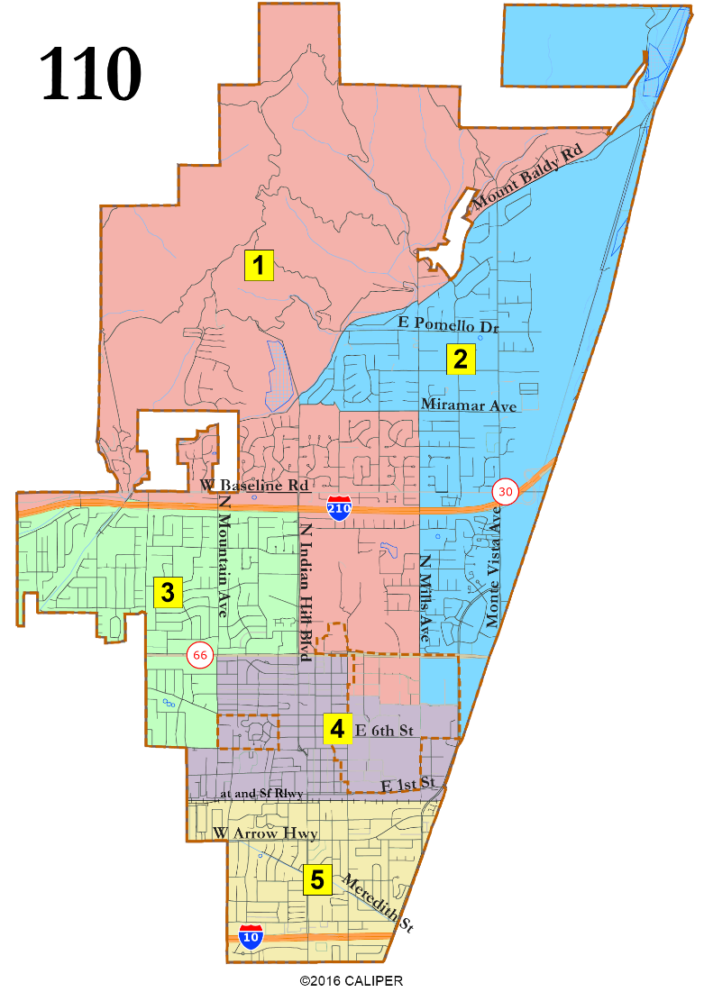
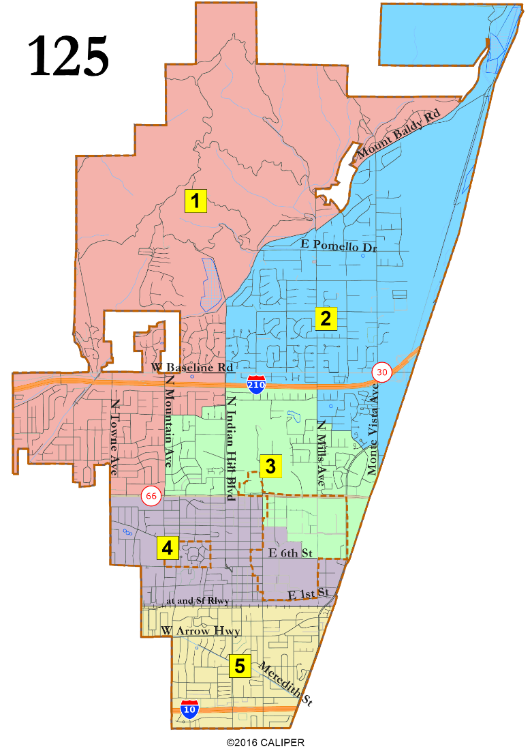
Regions with colleges divided
The Latino percentage of CVAP in D5 is 32% and the Asian-American CVAP in D2 is 18 or 20%. 110 divides the colleges in three; 125 in two. Neither divides Pilgrim Place. 110 follows major roads more closely, while 125 is more compact. 110 has one Council ‘pairing,’ while 125 has two pairs.

Slide 8
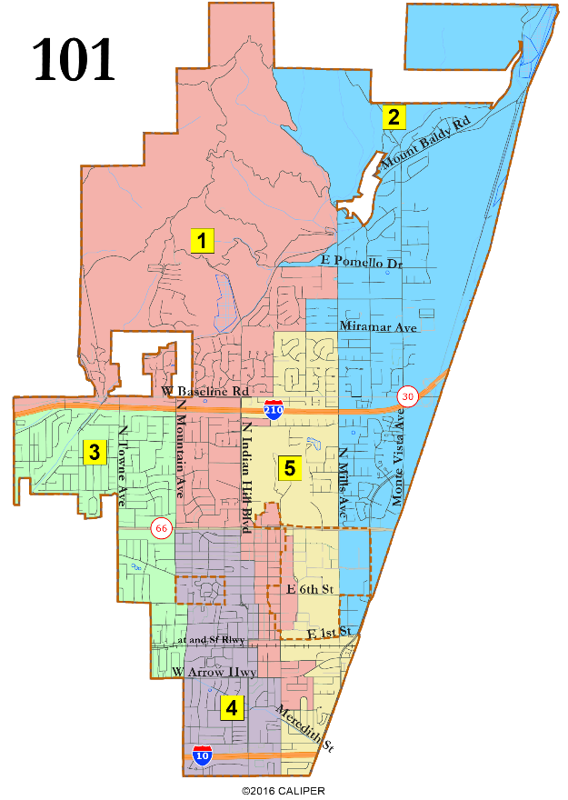
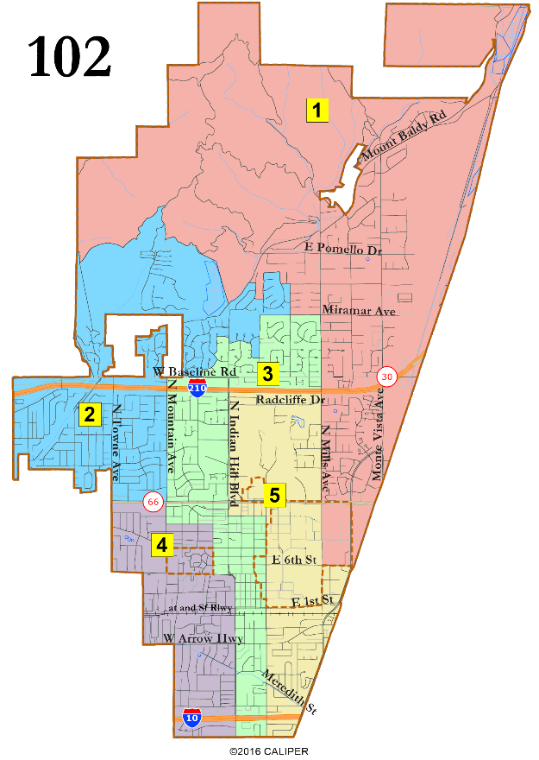
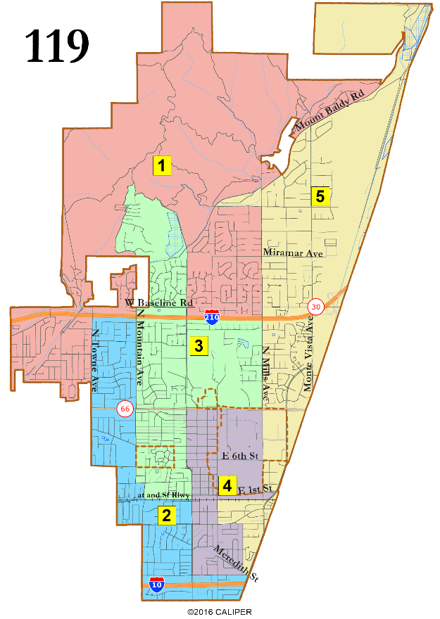
Vertical Maps with 3 in South
The Latino percentage of CVAP in all three is 26 to 29% in the most-Latino district.
The most-Asian-American district is 16 to 20% CVAP.
102 follows major roads the closest but “pairs” the most Councilmembers with the smallest Colleges split.
101 follows major roads except in the Colleges and the east end of Arrow Hwy.
119 brings the far northeastern District down to I-10, rather than the northwestern in 101 or the less-vertical 102.

Slide 9
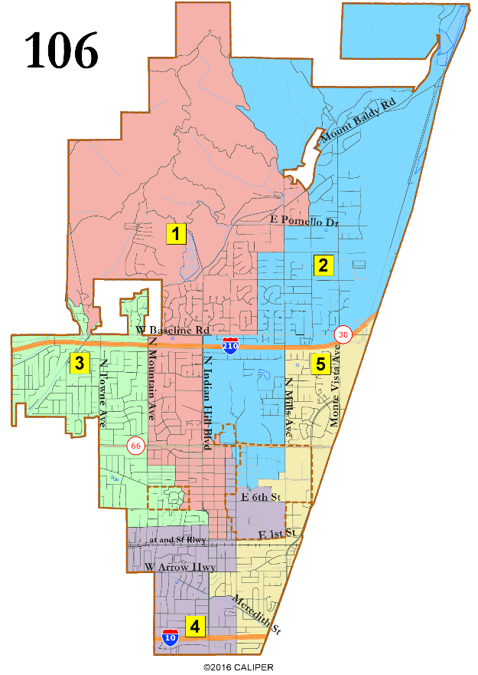
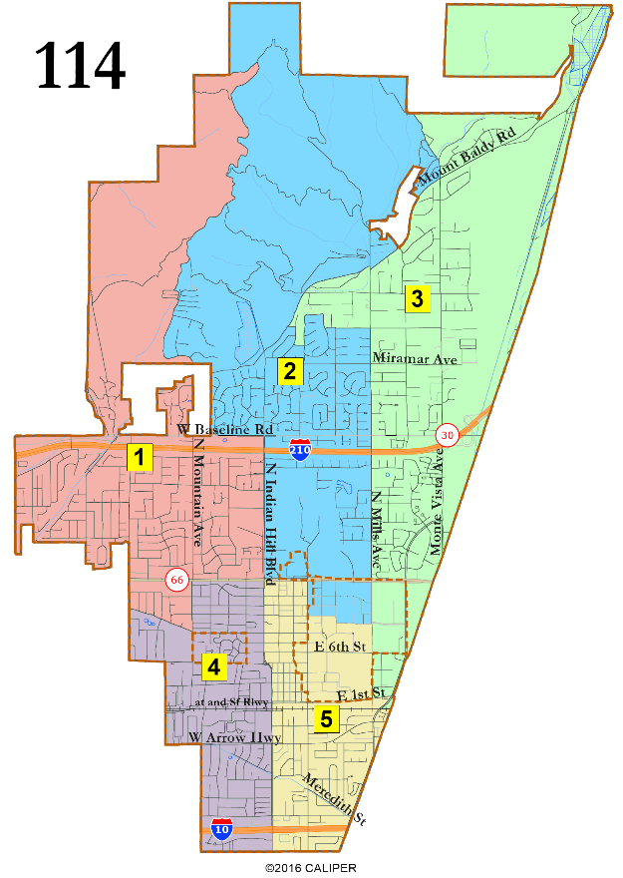
Vertical Maps with 2 in South
The Latino percentage of CVAP in all three is 25 to 27% in the most-Latino district. The most-Asian-American district is 19 to 21% CVAP.
106 and 107 divide Pilgrim Place. 114 does not. 106 brings D1 farther south into the Village, otherwise 106 and 107 are nearly identical. 106 and 107 have four districts across the Foothill-to-Baseline area, while 114 has three. 114 has three in the far north, while 106 and 107 have two.

Slide 10
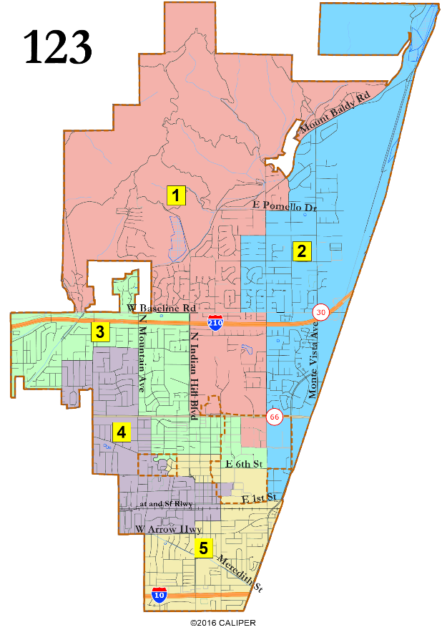
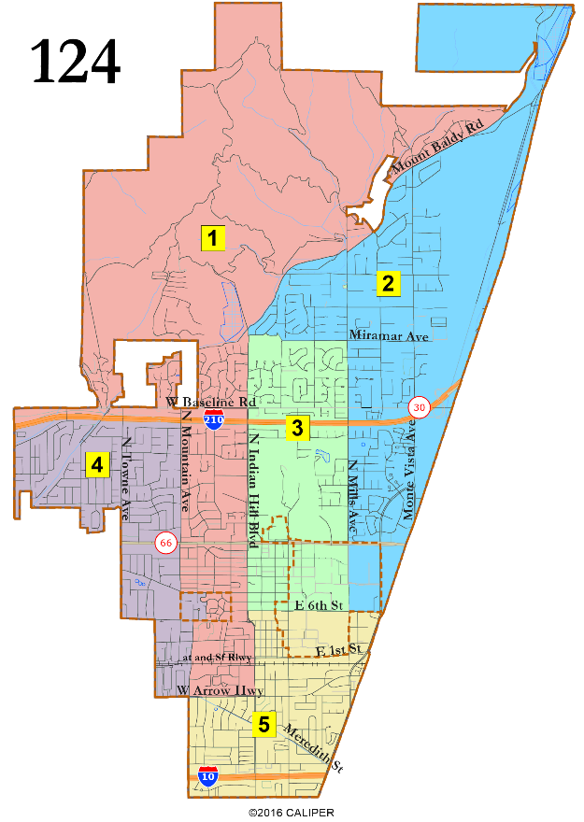
Vertical Maps with United South
For both, the Latino percentage of CVAP in D5 is 30% and Asian-American in D2 is 18%.
Both divide Pilgrim Place. 124 is more compact, while 123 divides the Colleges among all five districts and avoids any pairings. Both have four districts across the Foothill-to-Baseline region.

Slide 11
Suggested Focus Maps I (Regions)
Regions with United Colleges
Regions with Divided Colleges
These suggestions are intended only to start the conversation of how to get to two to four “focus” maps. There is no requirement to keep one from each group or to keep the one we suggest here.

Slide 12
Suggested Focus Maps II (Vertical)
Vertical with United South
Vertical with 2 in South
Vertical with 3 in South
These suggestions are intended only to start the conversation of how to get to two to four “focus” maps. There is no requirement to keep one from each group or to keep the one we suggest here.

Slide 13
Public Hearing
Which map or maps do you think are the best?
Which could you ‘live with’? Why?
What changes do you think would improve your favored maps?
City Districting Website
Interactive Review Map

