Slide 1
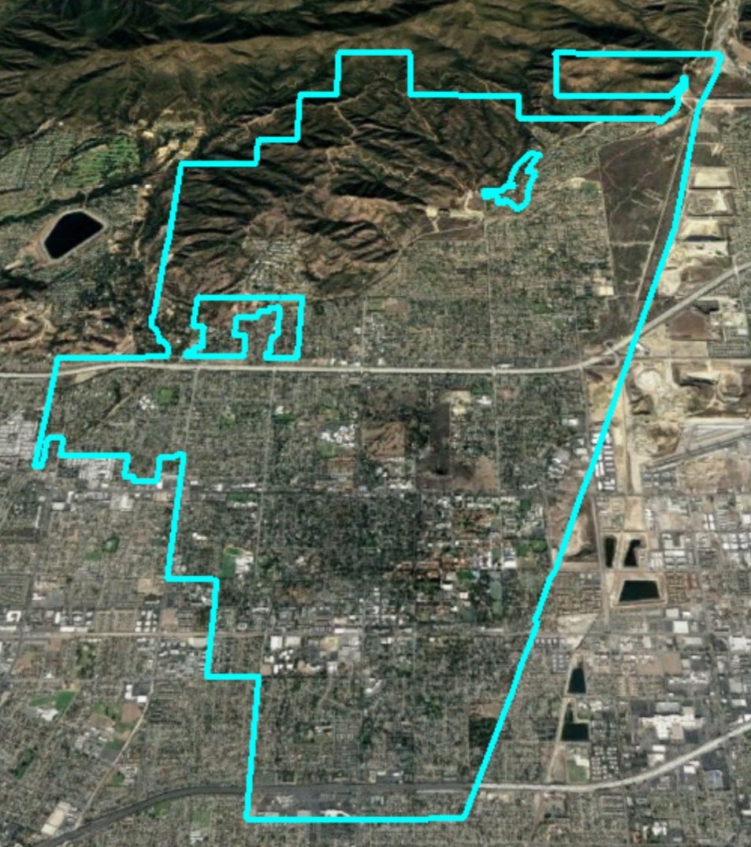
City of Claremont Introduction to Districting

Slide 2
California Voting Rights Act (CVRA)
Under the Federal Voting Rights Act (passed in 1965), a jurisdiction must fail 4 factual tests before it is in violation of the law.
The California VRA makes it significantly easier for plaintiffs to force jurisdictions into “by-district” election systems by eliminating two of the US Supreme Court Gingles tests:
Can the protected class constitute the majority of a district?
Does the protected class vote as a bloc?
Do the voters who are not in the protected class vote in a bloc to defeat the preferred candidates of the protected class?
Do the “totality of circumstances” indicate race is a factor in elections?
Liability is now determined only by the presence of racially polarized voting

Slide 3
CVRA Impact
Switched (or in the process of switching) as a result of CVRA:
At least 170 school districts
28 Community College Districts
100+ cities
1 County Board of Supervisors
10 water and other special districts.
Palmdale, Santa Clara and Santa Monica have gone to trial, and all of them lost (Santa Monica and Santa Clara are on appeal).
Palmdale spent $2 million on its defense
Santa Clara spent $500,000 so far
Santa Monica spent at least $5 million so far
Sample Settlement Payments to Plaintiffs:
Palmdale: $4.7 million
Modesto: $3 million
Highland: $1.35 million
Rancho Cucamonga: $1.3 million
Anaheim: $1.1 million
Whittier: $1 million
Santa Barbara: $600,000
Tulare Hospital: $500,000
Madera Unified: about $170,000
Hanford Joint Union Schools: $118,000
Merced City: $42,000
Placentia: $20,000

Slide 4
Districting Process
Step | Description
First Hearing: Jan. 8 | Held prior to release of draft maps. Education and to solicit input on the communities in the District.
Community Workshops: Jan. 13 | Presentation of demographics and overview of process to draw district maps. Question and answers.
Second Hearing: Jan. 17 | Held prior to release of draft maps. Education and to solicit input on the communities in the District.
Release draft maps | Maps must be posted at least 7 days prior to 3rd hearing.
First Hearing on Draft Maps: Feb. 4 | Two meetings to discuss and revise the draft maps and to discuss the election sequencing.
Community Workshops: Feb. 9 | Public input on draft maps and proposed sequence of elections.
Second Hearing on Draft Maps: Feb. 12 | Public hearing to discuss and take public comment on draft maps and proposed sequence of elections. Map selection & ordinance introduction.
2020 | First by-district elections
2021 | Map adjusted using 2020 Census data
2022 | Remaining districts hold first by-district elections

Slide 5
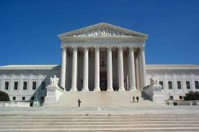
Districting Rules and Goals
Federal Laws
Traditional Redistricting Principles
Equal Population
Federal Voting Rights Act
No Racial Gerrymandering
Communities of interest
Compact
Contiguous
Visible (Natural & man-made) boundaries
Respect voters’ choices / continuity in office
Planned future growth

Slide 6
Demographic Summary
Latinos are 20% of the total population and 21% of the eligible voters (measured by Citizen Voting Age Population data).
Asian-Americans are 15% of eligible voters and African-Americans are 5%.
With 5 districts, each district would have about 6,985 residents.

Slide 7
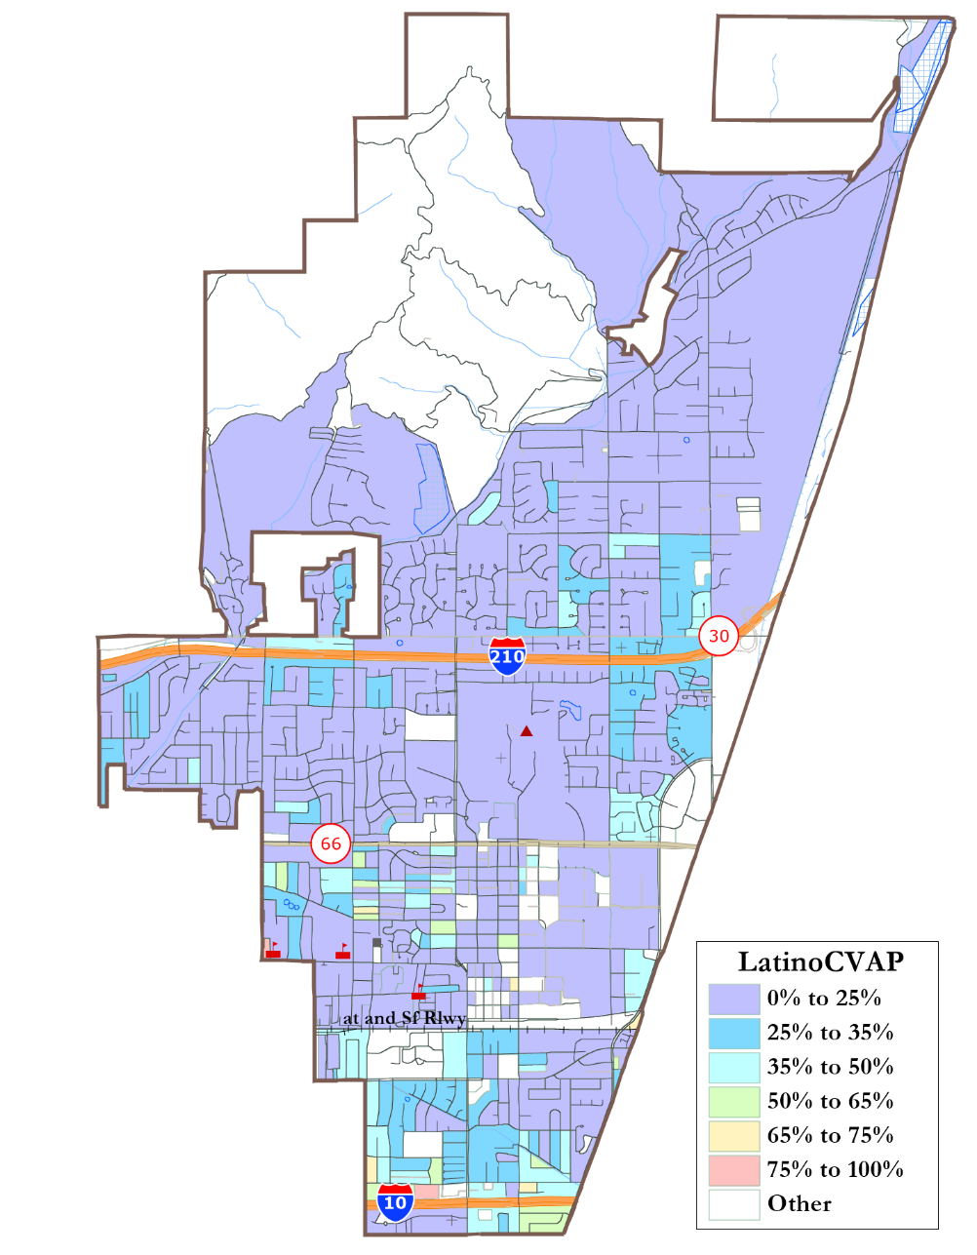
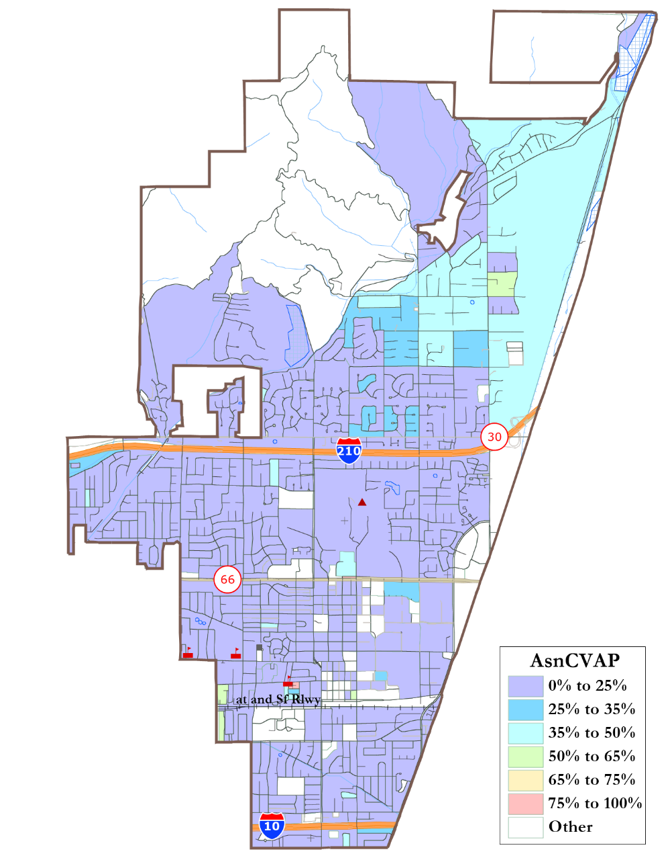
Protected Class Populations
Latinos are particularly concentrated around I-10.
Asian-Americans are particularly concentrated in the northeast.
There is no large concentration of African-American voters.

Slide 8
Defining Communities of Interest
1st Question: what is your neighborhood or community of interest?
A Community of Interest is generally defined as a neighborhood or community of shared interests, views, problems, or characteristics. Possible community feature/boundary definitions include:
School attendance areas
Natural neighborhood dividing lines, such as highway or major roads, rivers, canals, and/or hills
Areas around parks and other neighborhood landmarks
Common issues, neighborhood activities, or legislative/election concerns
Shared demographic characteristics
Such as similar levels of income, education, or linguistic isolation
2nd Question: Does a Community of Interest want to be united in one district, or to be divided to have a voice in multiple elections?

Slide 9
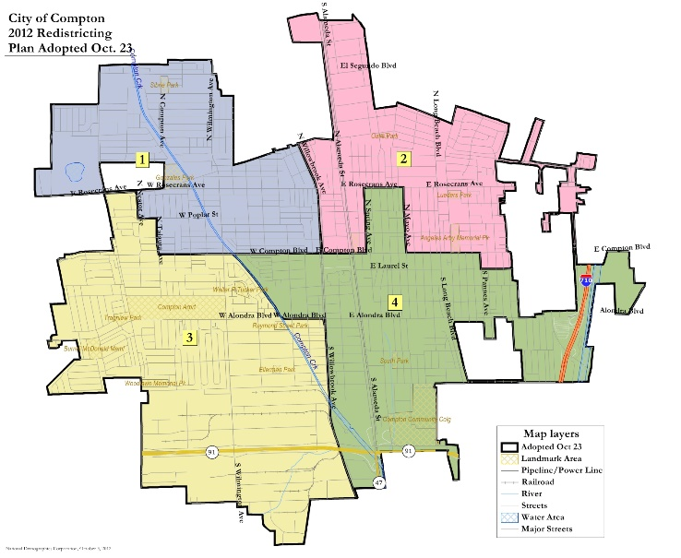
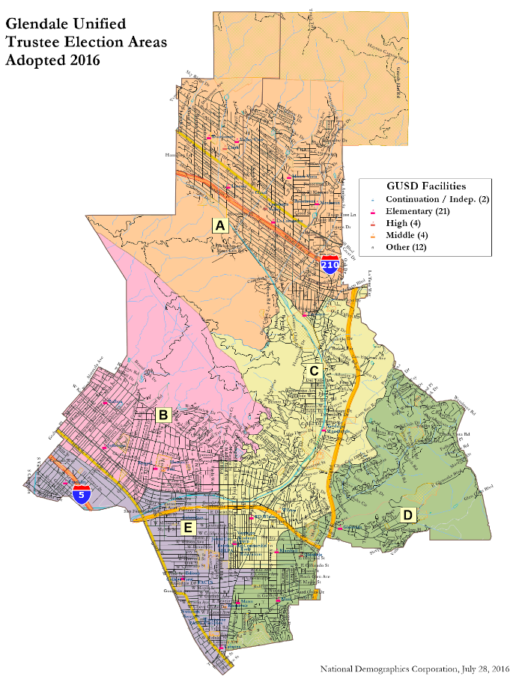
Sample Compact Maps
Compton
Glendale
Unified
Examples of highly compact maps, with nooks and jogs driven only by equal population requirements.

Slide 10
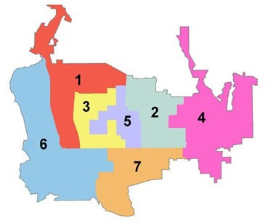
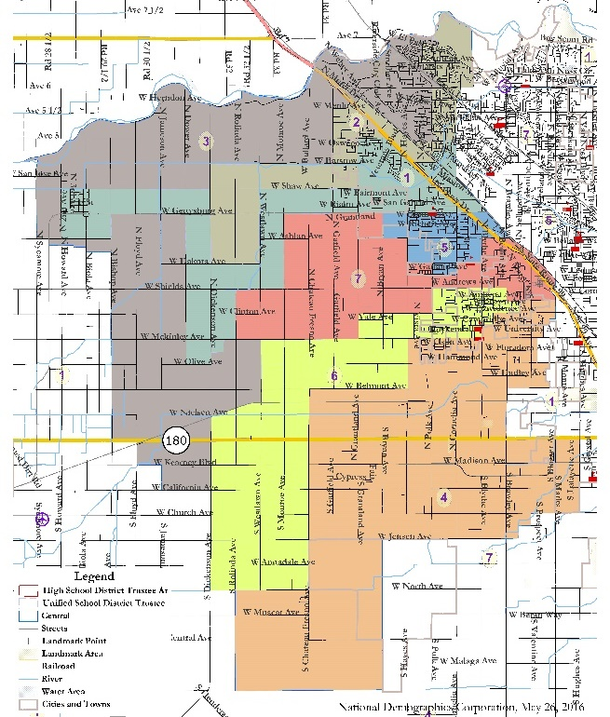
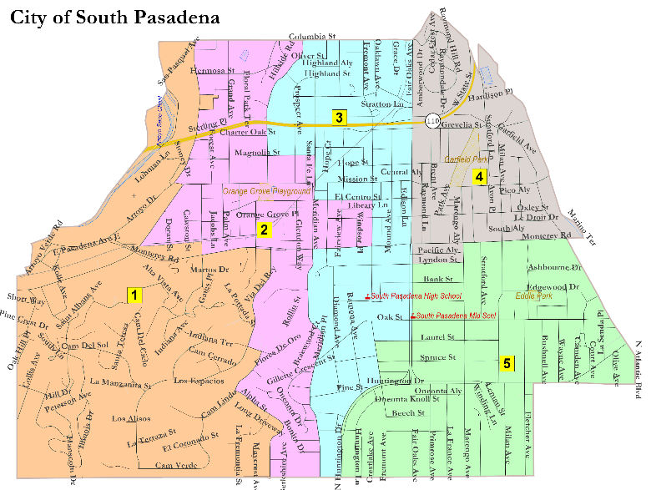
Sample Multiple-Representative Maps
Pasadena
Colorado Blvd.
Examples of maps where a desire to have all members touch downtown (Pasadena) or rural areas (Central), or as many neighborhoods as possible (South Pas), led to policy-driven but non-compact maps.
Central Unified

Slide 11
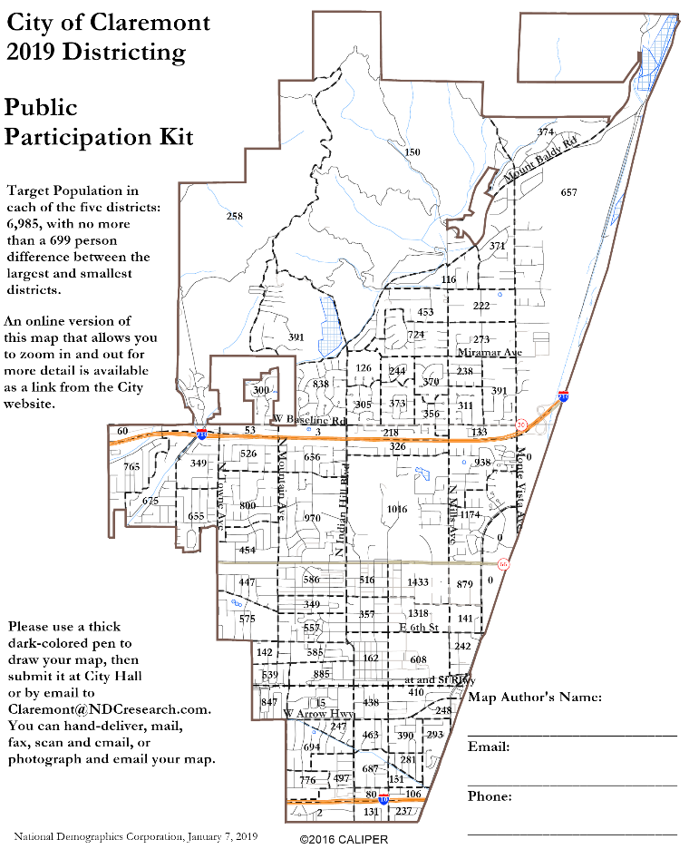
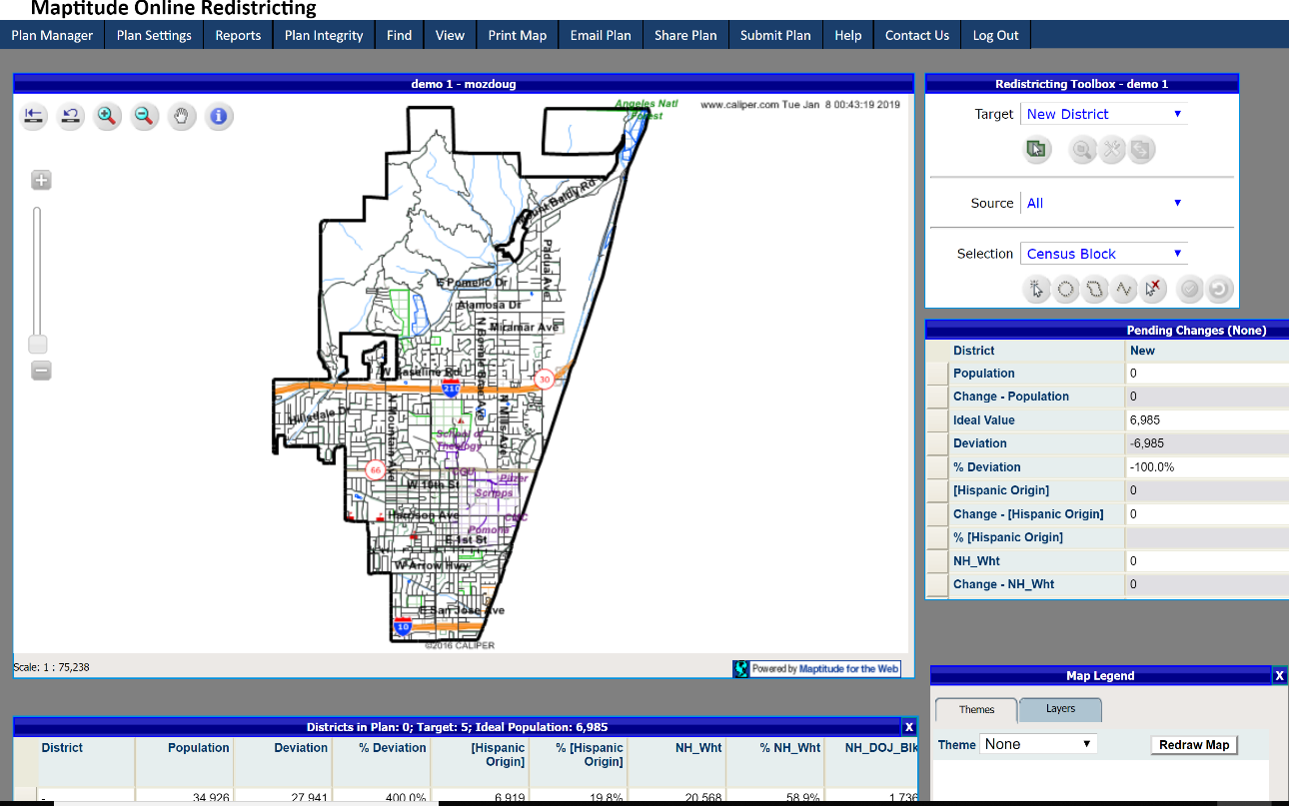
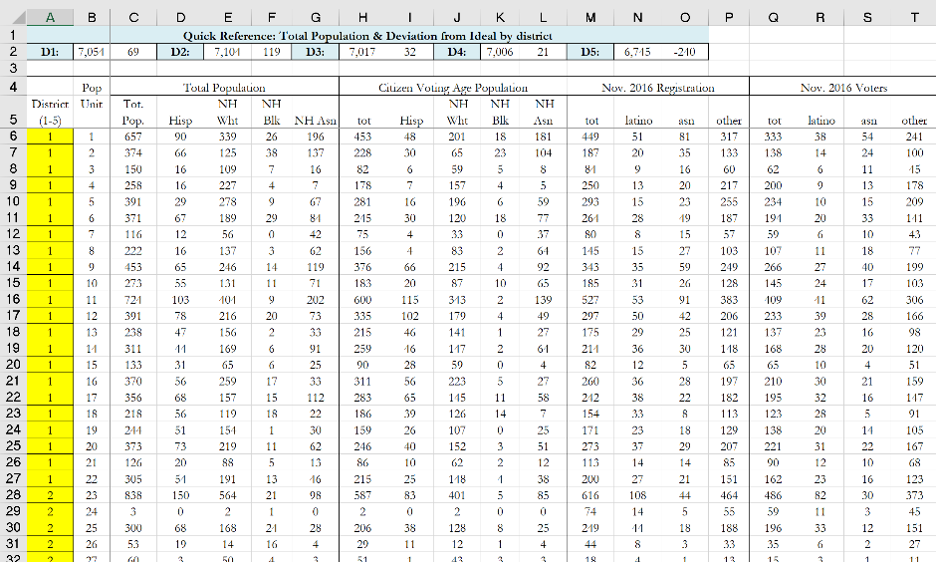
Public Map-Drawing Options
You have the opportunity to draw your own map proposal for the public and Council to consider.
You can sketch your lines on any city map, use the paper-based kit, use the Excel tool, or use the online mapping tool that the City is providing.
Paso Robles online mapper is under development. This image is from Simi Valley.

Slide 12
The Paper/PDF Public Participation Kit Option:
Draw your proposed districts, add up the numbers to be sure they are balanced, and send it in.
If you want to divide a Population Unit, simply note which Unit and the street where you want it divided and we will make that division if possible (divisions must be along Census Block lines, which usually follow streets).

Slide 13
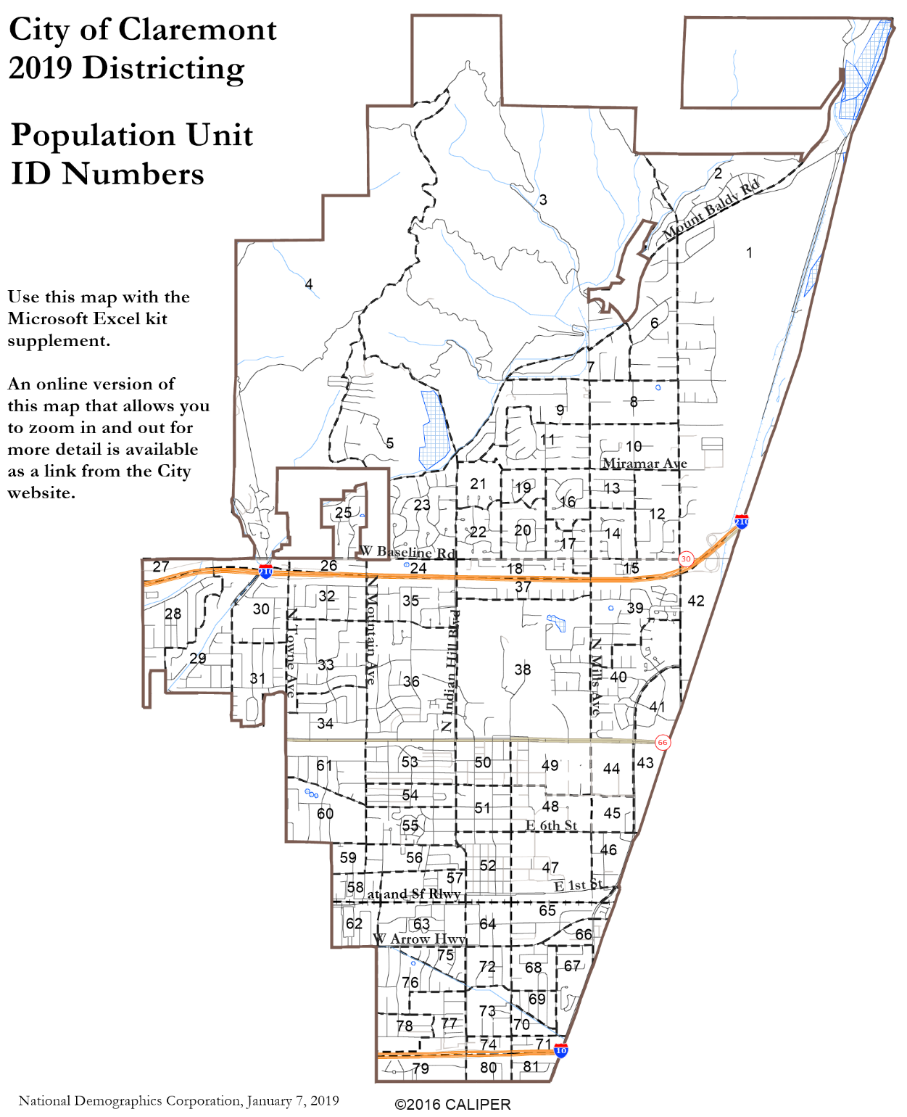
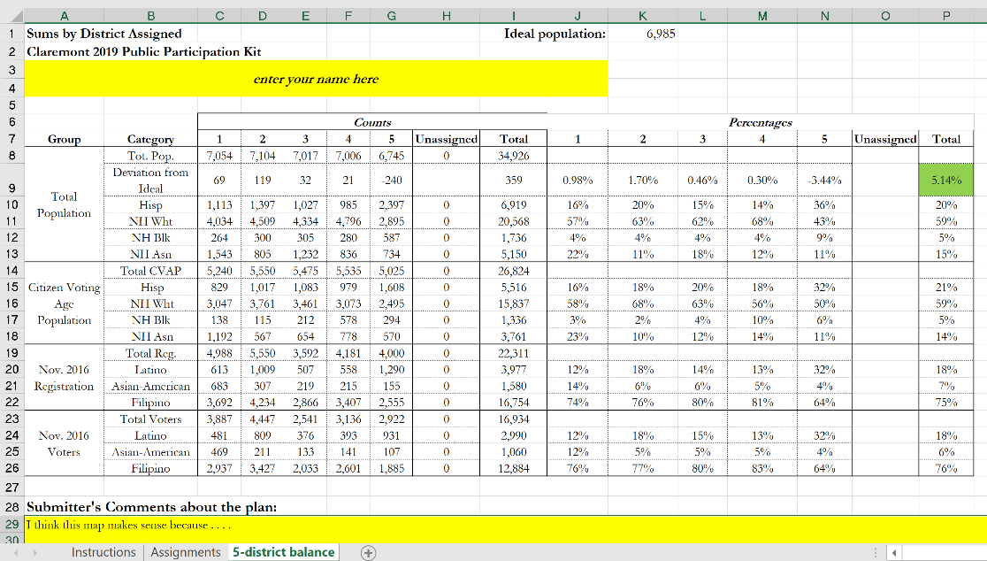
Paper/Excel Option
Enter the district assignment in the highlighted column, and Excel will calculate the resulting demographic changes.

Slide 14
Using the online tool
Online Mapping Tool
Tutorials and help resources are available from the login page.
Circled items:
1: controls to move around the map;
2: choose into which district selected territory will be placed;
3: options for how to select territory;
4: demographic summary of districts;
5: demographic change of currently selected area;
6: review map when finished;
7: submit map.
6
7
2
1
3
5
4

Slide 15
Public Hearing
What are the boundaries of your neighborhood or “community of interest”?
Do you want your neighborhood united in one district, or with multiple Councilmembers elected from it?
What neighborhoods do you think make sense to be with your neighborhood in a district or districts because of common city issues?
What other “communities of interest” do you see in the City?

