Slide 1
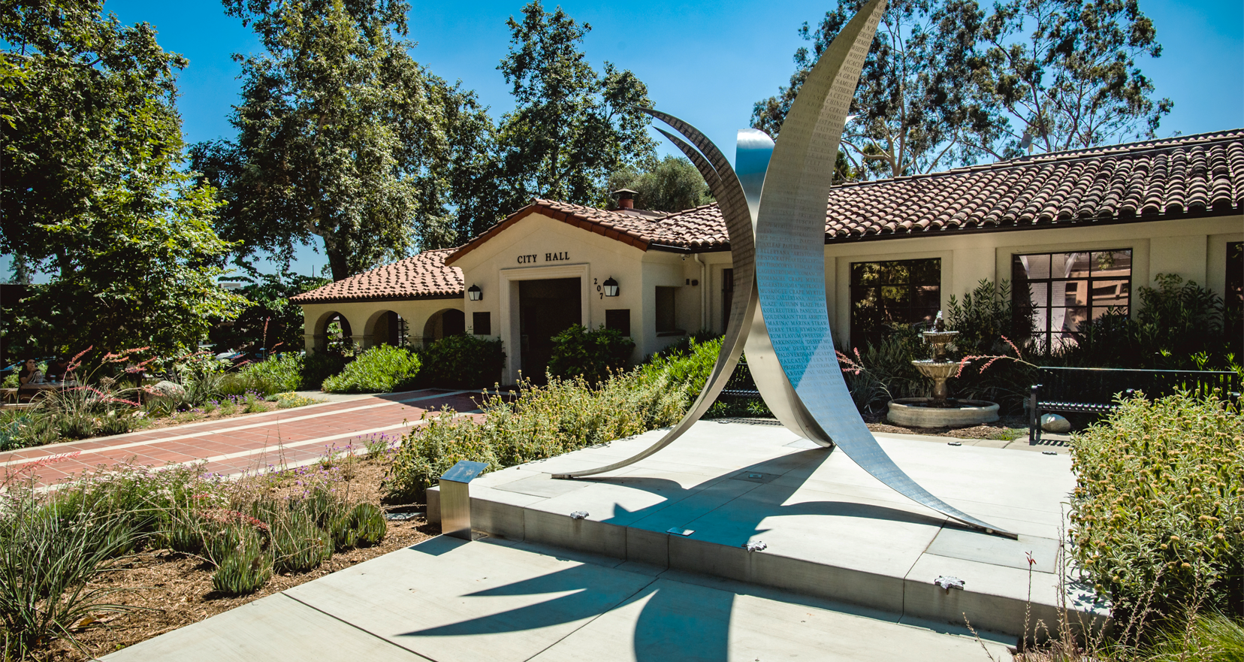
Annual Hotel/Motel Ordinance Report for Calendar Year 2023

Slide 2
Hotel/Motel Ordinance
After months of review and input from stakeholders, including the Claremont Planning Commission, the Claremont Police Commission, community members, City staff, and hotel/motel operators, a “new” Hotel/Motel Ordinance was presented to the City Council during a public hearing held on March 14, 2023.
The City Council approved the second reading and adoption of the ordinance at their regular meeting on March 28, 2023, making the ordinance a new, stand-alone chapter in the City’s Zoning Code.
Chamber of Commerce | September 14, 2022
2

Slide 3
New Requirements
A hotel/motel operator may not re-rent rooms when guests check out before their minimum length of stay has elapsed (i.e., 18 hours for motels; overnight for hotels).
The ordinance requires guests to provide a valid credit/debit card as a way to verify their identity (even if they are paying for their room with cash).
All hotels and motels are required to maintain a guest register that contains guest information specified in the ordinance, and employees are required to sign an attestation stating that a guest matches the photo on their Identification Document (ID).
All hotels and motels are required to scan images of a guest’s ID.
Permit parking is required for all hotels/motels.
Chamber of Commerce | September 14, 2022
3

Slide 4
New Requirements (cont.)
CCTV recording cameras are required in a hotel/motel’s common areas, entry points, and parking areas.
The ordinance explicitly outlines site and operational requirements, like security, cleanliness, room furnishings, and the condition of the exterior of the property and common areas.
The ordinance reflects the strictest possible inspection requirements that are permitted under current law.
Changes in hotel/motel operations were required to be completed within three months of ordinance adoption (July 27, 2023).
Changes that require physical improvements to the property must be completed within one year of Ordinance adoption (April 27, 2024).
Chamber of Commerce | September 14, 2022
4

Slide 5
CUP “Exceptions”
Several “exceptions” to requirements in the ordinance may only be granted to a hotel/motel operator if they are approved for a Conditional Use Permit (CUP):
A hotel or motel operator wants to allow for guest stays of more than thirty consecutive days.
A hotel or motel operator wants guests to be able to stay for more than sixty cumulative calendar days in a 180-day period.
A motel operator wants to rent rooms for periods of less than 18 hours.
A hotel operator wants to rent rooms for periods shorter than an “overnight stay.”
Chamber of Commerce | September 14, 2022
5
Hotel/Motel Ordinance | January 23, 2024

Slide 6
CUP “Exceptions” (cont.)
A hotel or motel operator wants to offer a “day use” program (i.e., hourly room rentals that do not require an overnight stay).
A hotel or motel operator wants to have the ability to re-rent rooms when guests check out before their minimum length of stay has elapsed (18 hours for motels; overnight for hotels).
A hotel or motel operator wants to utilize “digital check-ins.”
A hotel or motel operator does not want to implement a permit parking program.
A hotel or motel operator does not want to install CCTV cameras in their parking lot(s).
Chamber of Commerce | September 14, 2022
6
Hotel/Motel Ordinance | January 23, 2024

Slide 7
Additional Direction from City Council
In addition to approving the ordinance in March 2023, the City Council also directed staff to:
Offer an expedited CUP process and a flat rate ($1,250) for hotels/motel operators who apply for exceptions before October 27, 2023.
Establish a City Interdepartmental Team (CIT) to proactively address criminal and nuisance activity at hotels and motels, particularly at freeway motels.
Chamber of Commerce | September 14, 2022
7
Hotel/Motel Ordinance | January 23, 2024

Slide 8
Residence Inn (former Knights Inn/University Inn)
In March 2023, the Planning Commission voted to approve a CUP for the proposed Residence Inn by Marriott at the site of the current University Inn (formerly operated as Knights Inn). The CUP exceptions that were granted for the new hotel (once constructed and operating) are as follows:
Allowing guest stays of more than thirty consecutive days. Residence Inns are intended to accommodate longer stays. Although these stays rarely last more 30 consecutive days, it is an important part of the service model that the chain uses to attract business travelers and corporate employees. Similarly, the operator may also rent rooms to guests for more than sixty cumulative calendar days in a 180-day period.
Chamber of Commerce | September 14, 2022
8
Hotel/Motel Ordinance | January 23, 2024

Slide 9
Residence Inn (cont.)
While not anticipated to be a significant part of the business, the operator was granted the ability to offer a “day use” program (i.e., hourly room rentals that do not require an overnight stay) if this is something that Marriott wants to offer as a corporate-level program.
The operator was granted an exception to utilize “digital check-ins” for pre-qualified Marriott customers (i.e., certain Marriott Bonvoy Club members) if that becomes a requirement of the Marriott corporation.
The operator intends to use parking lot security gates as its parking permit program. If the gates are ever removed, the operator agrees to utilize a parking permit program as required by the Ordinance.
Chamber of Commerce | September 14, 2022
9
Hotel/Motel Ordinance | January 23, 2024

Slide 10
Hotel Casa 425
In October 2023, the Planning Commission approved Hotel Casa 425 for the following exceptions to the Hotel/Motel Ordinance:
Guest stays for longer than 30 days.
Cumulative stays for more than 60 days in a 180 day period.
Ability to utilize digital check-ins.
Ability to re-rent vacant rooms before the minimum length of stay has elapsed.
Ability to offer a “day use” program.
Exemption of video surveillance requirements in the hotel’s parking areas. Since Hotel Casa 425’s guest parking is in a public parking lot, video surveillance and related enforcement is operated by the Claremont Police Department.
Chamber of Commerce | September 14, 2022
10
Hotel/Motel Ordinance | January 23, 2024

Slide 11
DoubleTree by Hilton Hotel Claremont
In December 2023, the Planning Commission approved DoubleTree by Hilton Hotel Claremont for the following exceptions to the Hotel/Motel Ordinance:
Cumulative stays for more than 60 days in a 180 day period.
Ability to utilize digital check-ins.
Ability to re-rent vacant rooms before the minimum length of stay has elapsed (shorter than “overnight”).
Ability to offer a “day use” program.
Exemption of video surveillance requirements in the hotel’s parking areas.
Exemption of parking permit requirement for hotel guests (so long as the hotel continues to contract security personnel to monitor parking areas).
Chamber of Commerce | September 14, 2022
11
Hotel/Motel Ordinance | January 23, 2024

Slide 12
CIT Members
Members of the CIT are as follows:
Katie Wand, Assistant to the City Manager (CIT Team Lead)
Alisha Patterson, City Attorney
Corporal Michael Snyder, Claremont PD
Corporal William Livingston, Claremont PD
Matthew Guerrero, Community Improvement Coordinator
Jennifer Earl, Community Improvement Officer
Wendy Ramallo, Citizen Representative
Chamber of Commerce | September 14, 2022
12
Hotel/Motel Ordinance | January 23, 2024

Slide 13
CIT Reporting
When the ordinance was adopted, the City Council affirmed that the CIT would report its findings as follows:
Quarterly reports will be posted on the City’s website:
January – March activity was posted in April (Quarterly Report #1; Attachment B);
April – June activity was posted in July (Quarterly Report #2; Attachment C);
July – September activity was posted in November (Quarterly Report #3; Attachment D); and
October – December ‘23 activity was posted in January ’24 (Quarterly Report #4; Attachment E).
An annual report/presentation will be made to the City Council in January of each calendar year.
A comment form will be made available on the City’s website (to allow members of the public to provide feedback on hotels and motels).
Staff does not recommend changing these reporting guidelines for 2024.
Chamber of Commerce | September 14, 2022
13

Slide 14
Quarterly Report #1 Highlights
The establishment of the Proactive Building & Safety Inspection Program for Hotels/Motels in January 2023.
An Undercover Prostitution Detail conducted by the Claremont Police Department and the Los Angeles County District Attorney’s Office Bureau of Investigation in the area of Indian Hill Blvd. and the I-10 freeway (January 2023). During the enforcement detail, 16 subjects were arrested for soliciting a “Prostitute” for sexual acts.
The adoption of the Hotel/Motel Ordinance in March 2023.
Chamber of Commerce | September 14, 2022
14

Slide 15
Quarterly Report #2 Highlights
An Undercover Prostitution Detail conducted by the Claremont Police Department and the Pomona Police Department in the area of Indian Hill Blvd. and the I-10 freeway (April 2023). During the enforcement detail, 12 subjects were arrested for soliciting a “Prostitute” for sexual acts.
On-site CIT “Meet and Greets” with staff from the Double Tree by Hilton Claremont and the Claremont Lodge in June 2023.
Staff conducted outreach and offered support to all hotels/motels regarding the requirements imposed by the new ordinance.
Chamber of Commerce | September 14, 2022
15

Slide 16
Quarterly Report #3 Highlights
An Undercover Prostitution Detail conducted by the Claremont Police Department along with the Monterey Park Police Department, the Los Angeles County District Attorney’s Office Bureau of Investigation, and with the assistance of Claremont Motel 6 in the area of Indian Hill Blvd. and the I-10 freeway (July 2023). During the enforcement detail, 16 subjects were arrested for soliciting a “prostitute” for sexual acts.
Staff conducted a second round of voluntary inspections for each hotel/motel in September-October 2023 as part of the Proactive Building & Safety Inspection Program for Hotels/Motels.
Chamber of Commerce | September 14, 2022
16

Slide 17
Quarterly Report #4 Highlights
An Undercover Prostitution Detail conducted by the Claremont Police Department along with the Glendora Police Department, Upland Police Department, the Los Angeles County District Attorney’s Office Bureau of Investigation, and with the assistance of Claremont Motel 6 in the area of Indian Hill Blvd. and the I-10 freeway (October 2023). During the enforcement detail, 12 subjects were arrested for soliciting a “prostitute” for sexual acts.
CIT provided updates on the Proactive Building & Safety Inspection Program for Hotels/Motels as well as CUP exceptions that were granted by the Planning Commission in calendar year 2023.
Chamber of Commerce | September 14, 2022
17

Slide 18
Calls for Service – 2022 and 2023
Hotel/motel operators are continually encouraged to contact Claremont PD when there is criminal/nuisance activity occurring at their location.
In Q3 2023 (Quarterly Report #3), members of the CIT began compiling and tracking the following data points for each hotel/motel:
Frequency of police presence (proactive monitoring/not in response to a call for service, identified as “welfare checks” in the Quarterly Reports)
Police calls for service
Reported Code or Building violations
Reports of graffiti and other nuisance activity occurring at or adjacent to property
Moving forward, the CIT will explore comparing year-to-year calls/reports for service to monitor the effectiveness of the Hotel/Motel Ordinance and the perception of safety in the areas nearby hotels/motels.
Chamber of Commerce | September 14, 2022
18

Slide 19
Calls for Service – 2022 and 2023
 | Casa 425 | Claremont Lodge | Double Tree | Knights Inn/University Inn | Motel 6
2022 Welfare Checks | 0 | 110 | 8 | 118 | 427
2023 Welfare Checks | 0 | 48 | 6 | 38 | 219
2022 Calls for Service | 13 | 94 | 116 | 189 | 359
2023 Calls for Service | 18 | 71 | 100 | 53 | 208
Chamber of Commerce | September 14, 2022
19

Slide 20
Questions?
Chamber of Commerce | September 14, 2022

